Slide 1
Total Life Manager Update
Stephen Johnson, Logan Grisham, Sebastian Hardesty

Slide 2
Changes - Tools
Stack
LAMP to MERN to LAMP
Lamp - Linux, Apache, MySQL, PHP
MERN - MongoDB, ExpressJS, ReactJS, NodeJS
Graphs
ReactJS graphing libraries to standard HTML Canvas to ChartJS

Slide 3
Changes - Pages
Removed
FAQ and Support
Landing
Meals
Login
Background Slideshow vs. Static
Saving user login information vs. Not Saving
Graphs
One graph, multiple lines vs. Multiple graphs

Slide 4
Changes - Focus
Away From
Email Verification - Login options
Changing Account Info - User data
Login Recovery - Later feature
Aesthetics
Towards - Functionality
Graphs
Dashboard
Calendar

Slide 5
Complete - Backend
Server
Live testing
Login/Signup
Users can create a login or use an existing login
Database
Server integration

Slide 6
Complete - Frontend
Hamburger menu
Navigation
General Layout and color scheme
Login/Signup page

Slide 7
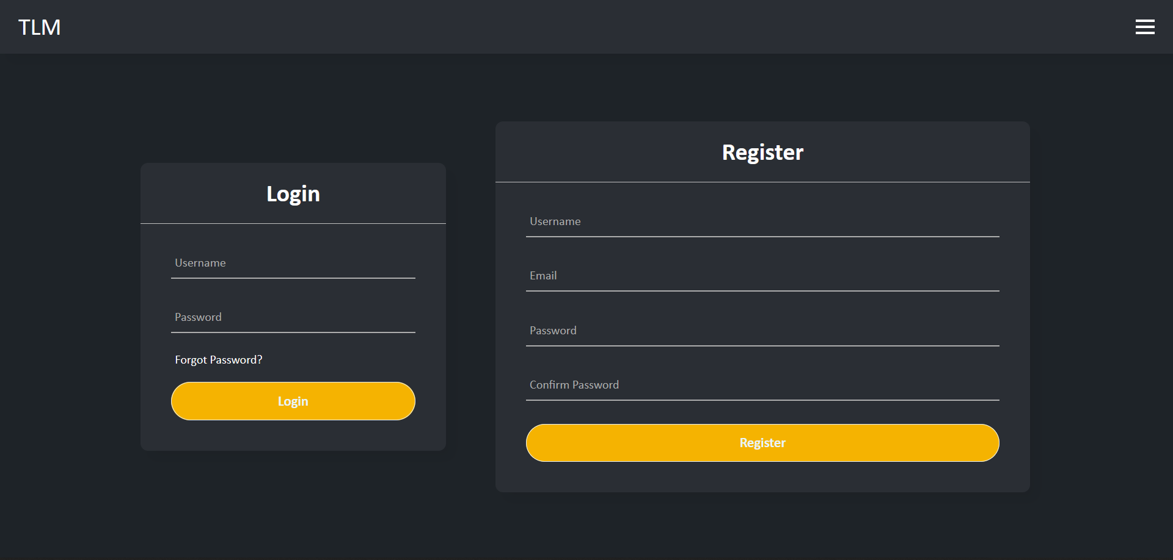
Login/Signup Page

Slide 8
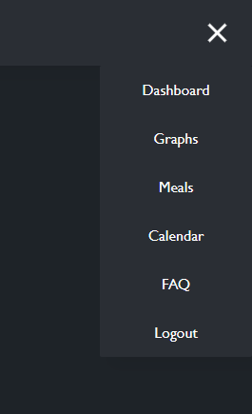
Hamburger Menu
The expanded hamburger menu
Still lists abandoned pages

Slide 9
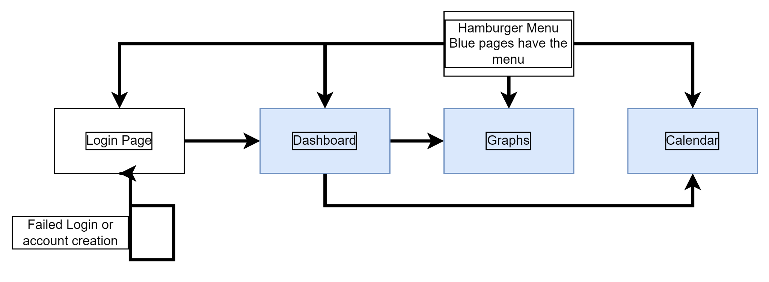
Updated Design Diagram

Slide 10
In-progress
Graphs
Adds data from same day
Dashboard
Graph integration, widgets (weather and calendar)
Stat rings for user data

Slide 11
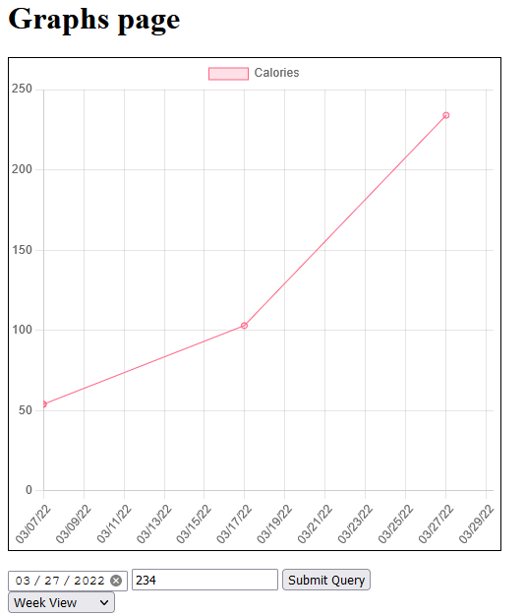
Graphs
The Graphs page without CSS and with some sample input
Dates, views, clearly colored categories

Slide 12
Not currently Implemented - In progress
Graphs
ChartJS, Limits on data representation
Pulling data from the database
Dashboard
Widgets, Stat Rings
Login/Sign-Up (style changes)

Slide 13
Not Currently Underway
Calendar page and dashboard widget
Weather widget
Login recovery
Email validation
User account display and modification

Slide 14
Addressable but removed
Landing Page
Meals page
Email login/signup
User detailed information
Weight, height, etc.

Slide 15
Potential Delimiters - What will hinder the project!
Unfamiliar Technology
PHP, ChartJS
Page Overload
Too many pages, features, ambitions

Slide 16
How we are addressing these issues
Unfamiliar Technology(PHP, ChartJS)
PHP - Creating the actual modules
ChartJS - Testing sample inputs
Page Overload
Temporarily removing pages
Getting functionality before style

Slide 17
Concluding points
General structure has remained the same
Pages were reduced, but may see a return in the final version
Minor technology changes have quickened development
Unfamiliar technology setbacks

